Slide 1







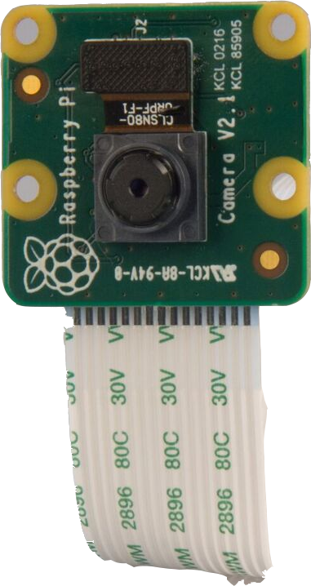



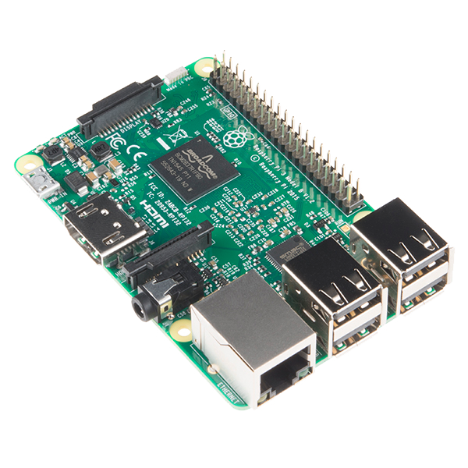

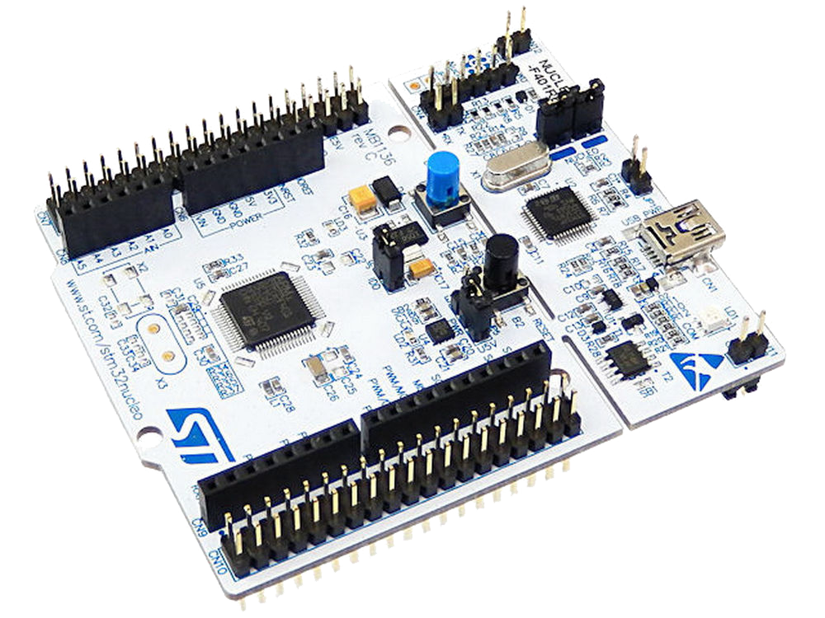

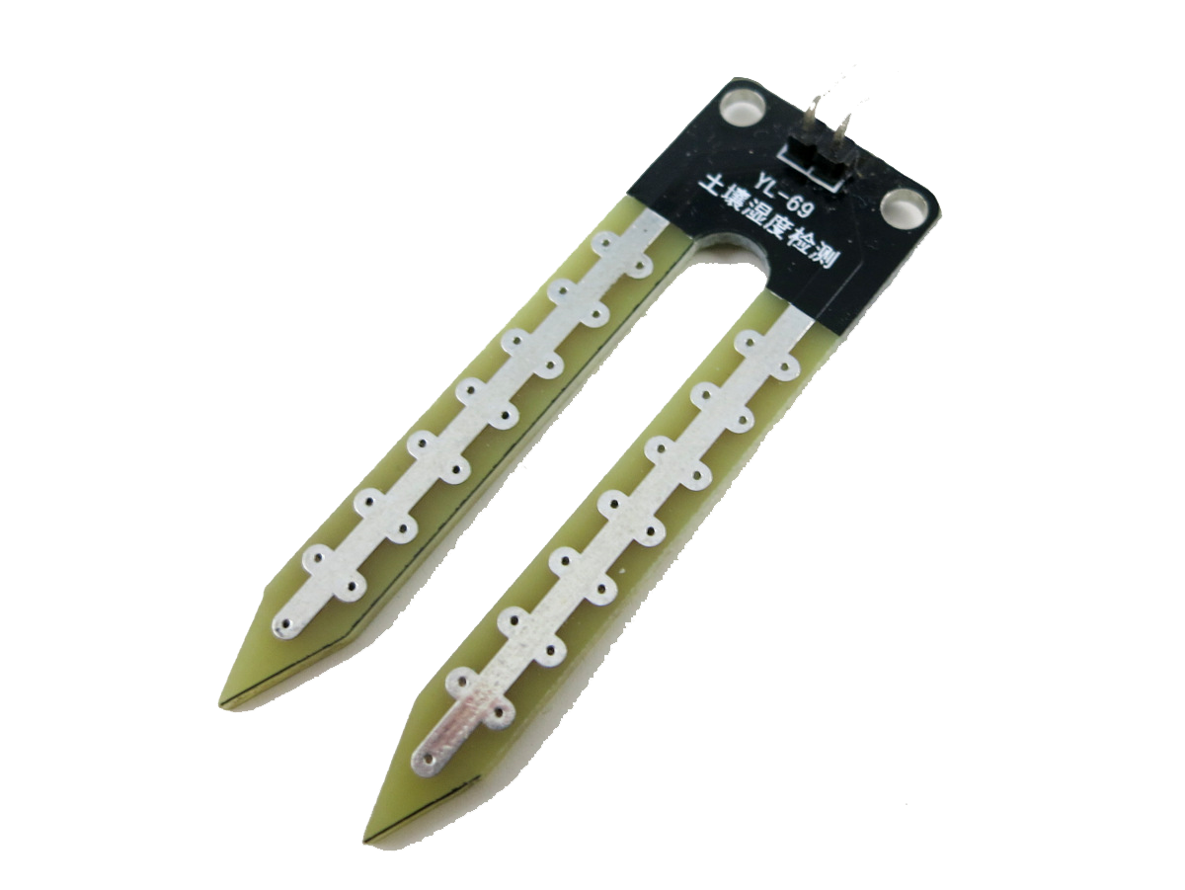






Hoykhom
King Mongkut's Institute of Technology Ladkrabang

Slide 2

Hoykhom
King Mongkut's Institute of Technology Ladkrabang

Slide 3

Hoykhom
King Mongkut's Institute of Technology Ladkrabang

Slide 4

Hoykhom
King Mongkut's Institute of Technology Ladkrabang

Slide 5


Hoykhom
King Mongkut's Institute of Technology Ladkrabang

Slide 6

Push and reply

Slide 7


Data Analytics

Slide 8
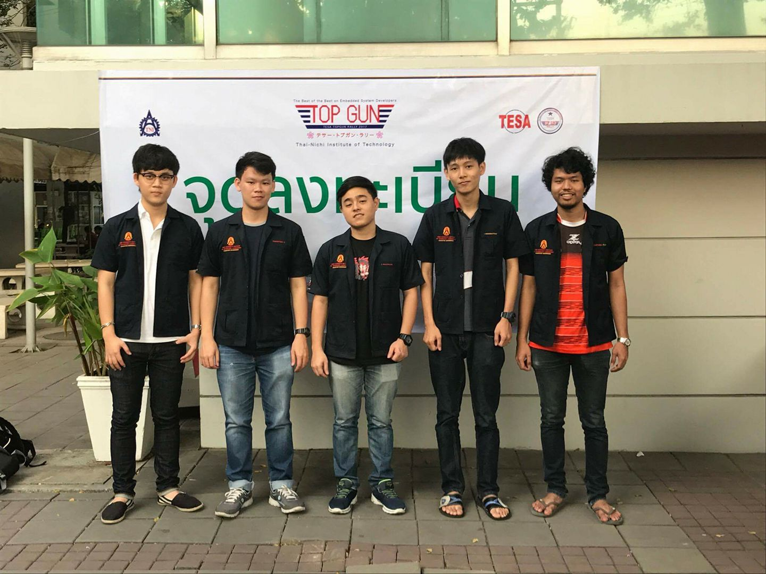
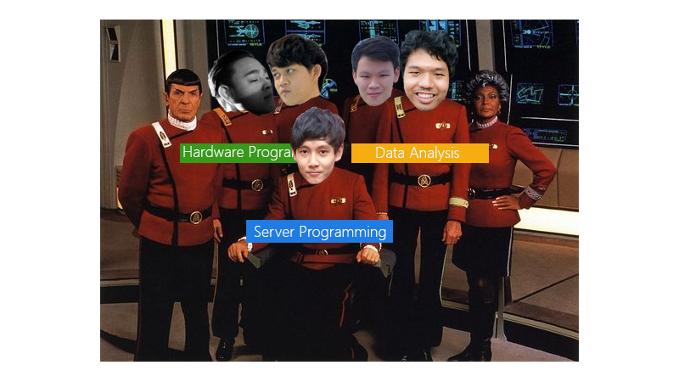
Teamworks!

Slide 9
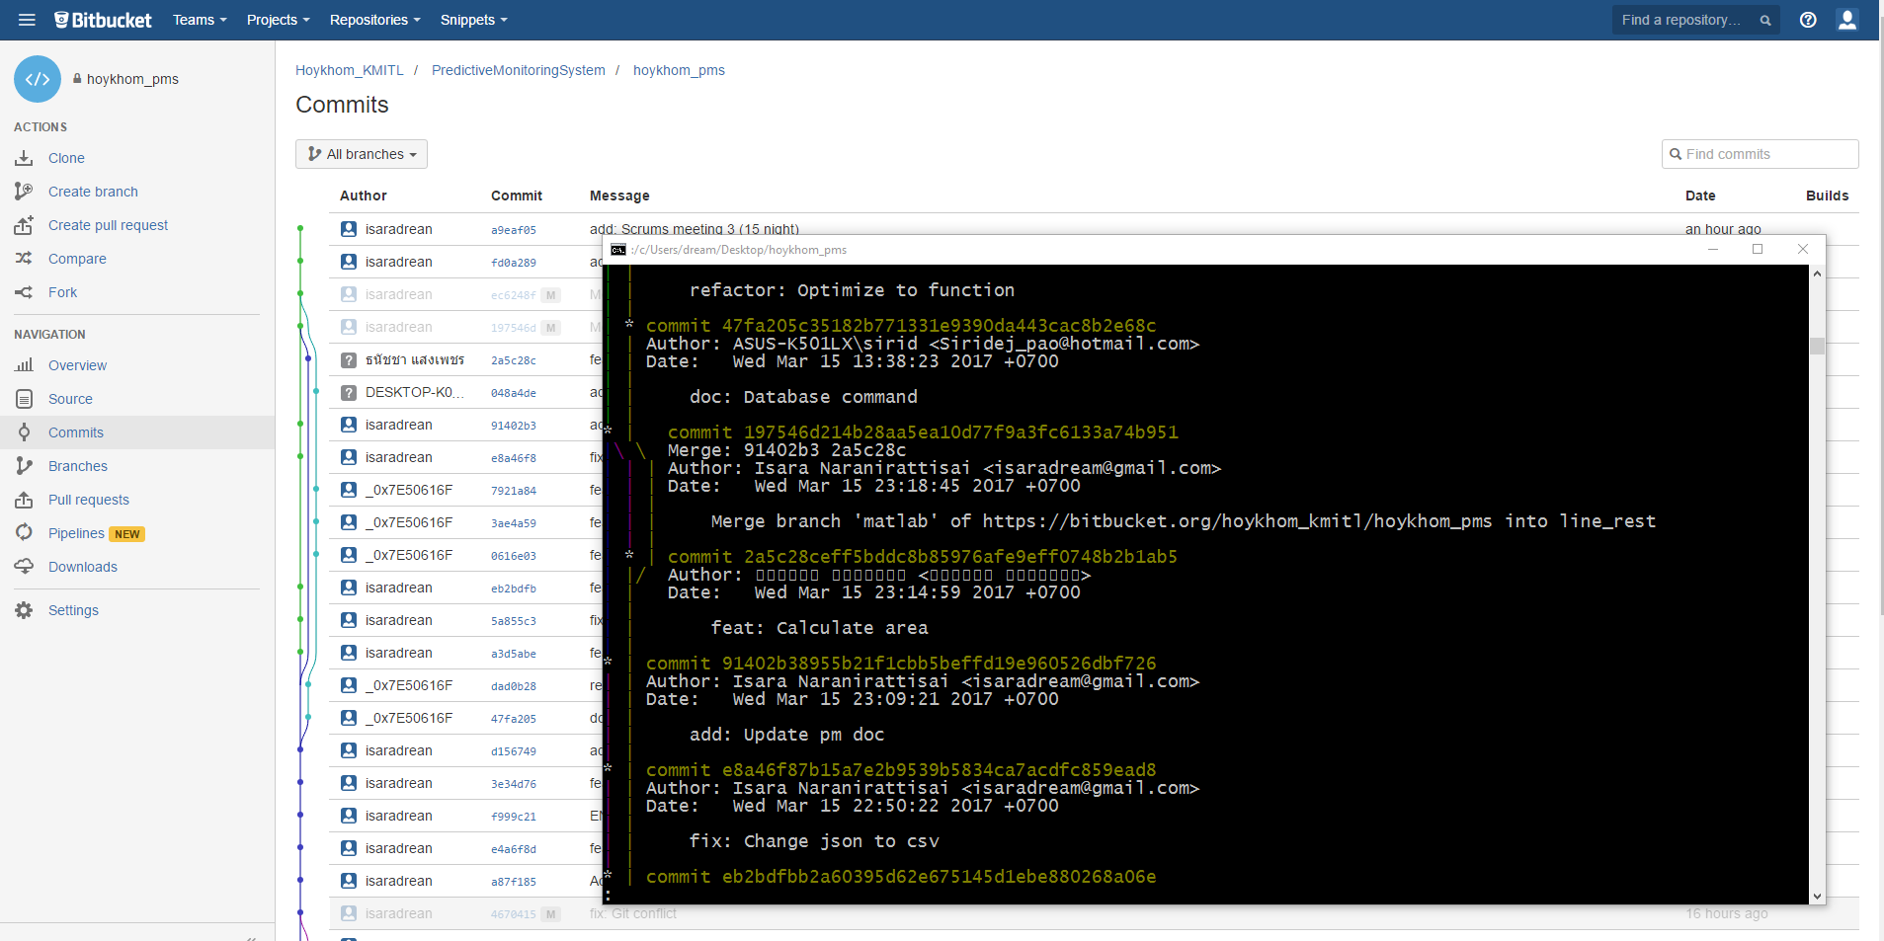
Teamworks! (1)

Slide 10
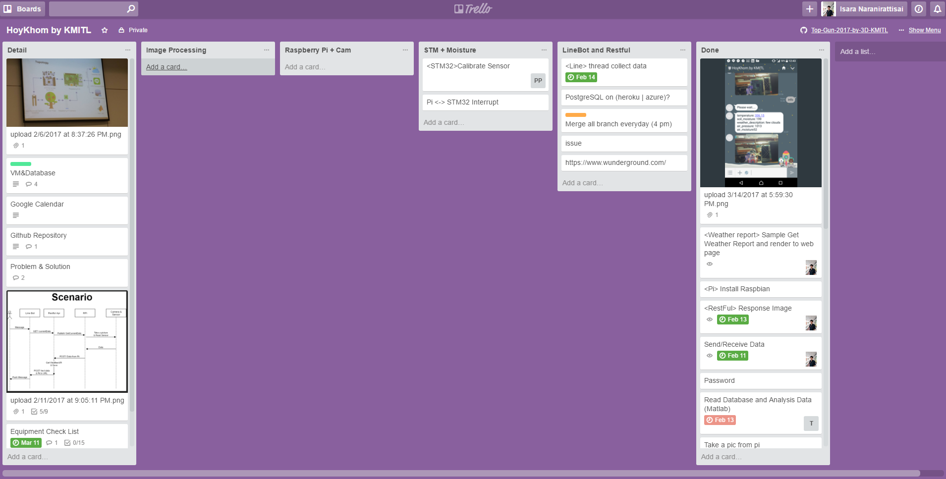
Teamworks! (2)

Slide 11
Teamworks! (2)

